Slide 1
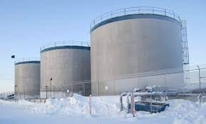
ADAC Year 7 Annual Meeting
...Via Conference Call, 2-3 June 2021
ADAC Project Briefing
Arctic Facilities and Infrastructure Environmental Change Risk Index (ERI)
Dr. Craig Tweedie, University of Texas El Paso
Dr. Matt Calhoun, University of Alaska Anchorage

Slide 2
Environmental Change Risk Index (ERI):
Research Team
ADAC Program Year 7 Annual Meeting 2-3 June 2021
Project Investigators:
Dr. Craig Tweedie, University of Texas El Paso
Dr. Matt Calhoun, University of Alaska Anchorage
Project Supporting Researchers:
Dr. Ben Jones, Institute of Northern Engineering, University of Alaska Fairbanks, Fairbanks AK.
Ms. Kelsey Frazier, ADAC Research Associate, UAA.
Mr. Jeff Libby, Director, Applied Environmental Research Center (AERC), UAA
Dr. Molly Grear, Pacific NW National Laboratories, Sequim, WA. (TBC)
Mr. Nagruk Harcharek, Ukpeaġvik Iñupiat Corporation, Utqiaġvik, AK.
Project Advisors:
Tom Douglas, Cold Regions Research and Engineering Laboratory, Ft Wainwright AK.
Givey Kochanowski, Alaska Senior Advisor for the U.S. Department of Energy (DOE) Office of Indian Energy, Anchorage, AK.

Slide 3
Environmental Change Risk Index (ERI):
Research Team
ADAC Program Year 7 Annual Meeting 2-3 June 2021
Project Evaluators:
Dr. Nancy Kinner University of New Hampshire, Durham NH
TBA
Project Champions
Ms. Galia Kaplan and MSTC Douglas Furman, Office of Port and Facility Compliance CG-FAC, Headquarters (HQ) U.S. Coast Guard (USCG), Washington D.C.
Project Stakeholders:
Mr. Dan Lawrence, CG-OES, HQ USCG Washington D.C.
CDR Wes James, Office of Marine Environmental Response CG-MER, HQ USCG Washington D.C.
Mr. Shannon Jenkins, Senior Arctic Policy Advisor, CG 5PW, HQ USCG Washington D.C.
Dr. Phil McGillivary, Science Advisor USCG Pac Area, Alameda CA
Mr. Phil Thorne, Arctic Planner, USCG District 17, Juneau, AK.
Mr. Mark Everett, USCG District 17, Juneau, AK.
LCDR Jereme Altendorf, USCG District 17 Sector Anchorage, AK.

Slide 4
ADAC Program Year 7 Annual Meeting 2-3 June 2021
Environmental Change Risk Index (ERI):
Description & Baseline
Project Description
Arctic region is exposed to impacts of climate change, increased coastal erosion, more frequent precipitation, permafrost thawing, and retreating sea ice
Imminent threat of coastal infrastructure failure and catastrophic environmental impacts
Project responds to direct request by D17 to provide environmental risk index for infrastructure/facility under USCG purview
Fuel storage facility in Shaktoolik, Alaska, a USCG regulated facility.

Slide 5
ADAC Program Year 7 Annual Meeting 2-3 June 2021
Environmental Change Risk Index (ERI):
Description & Baseline
Project Description… continued
Alaskan USCG-regulated (under 33CFR154) bulk oil facilities and associated infrastructure that persist on permafrost coastal/riverine landscapes that are susceptible to environmental change, namely:
  bulk oil/fuel facilities and/or piers,
  platforms,
  pipelines and
  loading docks near coastal regions or nearby/adjacent waterways.
Facilities/infrastructure may be horizontal or vertically constructed.
Project team takes a multi- and intradisciplinary approach
Active coordination planned between project team, Arctic scientists, engineers, and other stakeholders
Fuel storage facility in Shaktoolik, Alaska, a USCG regulated facility.

Slide 6
ADAC Program Year 7 Annual Meeting 2-3 June 2021
Environmental Change Risk Index (ERI):
Description & Baseline
Project Baseline
Review of existing published research has not determined any associated suitable, fine scale characterization of environmental risk to Arctic coastal region bulk storage facilities or infrastructure in coastal areas that may be at risk to degradation of coastal erosion or permafrost thaw.
Extraordinary logistics and associated costs of travel to remote/off road system rural Alaska facilities and the short summer season to safely conduct inspections, USCG regulated facility inspectors are challenged with completing necessary critical inspections of potentially hazardous coastal facilities (such as fuel storage tanks) on an annual basis
Other operational and response personnel are routinely challenged with evaluating and mitigating the additional risk associated with a rapidly eroding and increasingly unstable coastal landscape across the U.S. Arctic
There is a need to increase the fidelity of operational planning and risk mitigation strategies by supporting existing area familiarization and local knowledge with an increased technical understanding of key environmental processes contributing to rapid change and instability, providing operators with greater detail of expected on scene conditions and a clearer picture of associated risks.
Fuel storage facility in Shaktoolik, Alaska, a USCG regulated facility.

Slide 7
ADAC Program Year 7 Annual Meeting 2-3 June 2021
Environmental Change Risk Index (ERI):
Relevance and Methods
Relevance to DHS and USCG
The project will primarily focus on bulk oil/fuel containers and pipelines, and piers, docks, and platforms in permafrost coastal and riverine landscapes of the Bering, Chukchi and Beaufort Seas
Products will inform responders and inspectors of the current and predicted future structural integrity of those facilities, and the bearing capacity, stability, and susceptibility to erosion of the surrounding/ supporting landscape
The research effort will produce three products: a comprehensive Arctic facilities and infrastructure environmental change knowledge product, an operationally relevant Arctic facilities and infrastructure environmental change risk index, and an Arctic inspector and responder structural environmental impacts training guide.

Slide 8
ADAC Program Year 7 Annual Meeting 2-3 June 2021
Environmental Change Risk Index (ERI):
Relevance and Methods
Methods and Overarching Objectives
This project will create and publish three knowledge products:
Synthesis of published literature, existing data, USCG reporting, and expert opinion.
Develop an “Arctic facilities and infrastructure environmental change” risk index as a USCG decision support tool.
Transition products that can be promulgated to the USCG, stakeholders, and the broader scientific and engineering community.

Slide 9
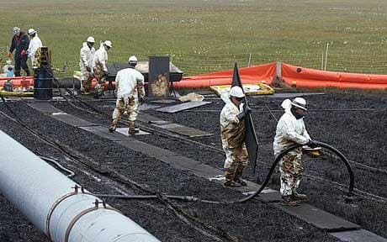
ADAC Program Year 7 Annual Meeting 2-3 June 2021
Environmental Change Risk Index (ERI):
Relevance and Methods
Objective 1: Baseline Synthesis
Core questions/ sub-objectives:
  What environmental phenomenon, and/or structural engineering, and other factors are associated with infrastructural degradation or inspection failure?
  How are environmental phenomenon associated with infrastructure degradation or inspection failure changing?
  How adept are past and present engineering and inspection practices suited to the changing environment?
Associated product/deliverable(s):
  Knowledge product that provides USCG with a report ~ literature review and synthesis of acquired data.
  Provide baseline product to Stakeholders that will be useful for additional activities.
March 2006: Prudhoe Bay spill

Slide 10
ADAC Program Year 7 Annual Meeting 2-3 June 2021
Environmental Change Risk Index (ERI):
Relevance and Methods
Objective 2: Risk Index Development
Core questions/ sub-objectives:
  What key engineering and or environmental factors, conditional states, and thresholds best predict infrastructure or inspection failure in the US Arctic?
  Can a risk index model for infrastructure failure adequately predict known infrastructure failure events?
  Using a validated risk index of infrastructure failure, what are the forecast spatiotemporal patterns for infrastructure failure in the US Arctic?
  How can facilities and infrastructure inspection and monitoring be modified to improve the early detection of infrastructure failure?
  What are the key uncertainties, priorities for risk reduction, and future research priorities that arises from this project?
March 2006: Prudhoe Bay spill

Slide 11
ADAC Program Year 7 Annual Meeting 2-3 June 2021
Environmental Change Risk Index (ERI):
Relevance and Methods
Objective 2: Risk Index Development
Associated product/deliverable(s):
  Validated risk index and associated analysis of uncertainty.
  Integrated environmental, infrastructural data drawn from published literature, data archives, change analyses, inspection and incident reports, and/or models .
  Review of USCG inspection and structural monitoring approaches.
March 2006: Prudhoe Bay spill

Slide 12
ADAC Program Year 7 Annual Meeting 2-3 June 2021
Environmental Change Risk Index (ERI):
Relevance and Methods
Objective 3: Transition Products
Core questions/ sub-objectives:
  Develop an optimized and operationally relevant transition plan and guidelines for improved infrastructure inspection and monitoring.
  Share findings with project stakeholders.
  Share findings with the broader scientific and engineering community.
Associated product/deliverable(s):
  Validated risk index and associated analysis of uncertainty.
  Integrated environmental, infrastructural data drawn from published literature, data archives, change analyses, inspection and incident reports, and associated environmental characterization models.
  Review of USCG inspection and structural monitoring approaches.
March 2006: Prudhoe Bay spill

Slide 13
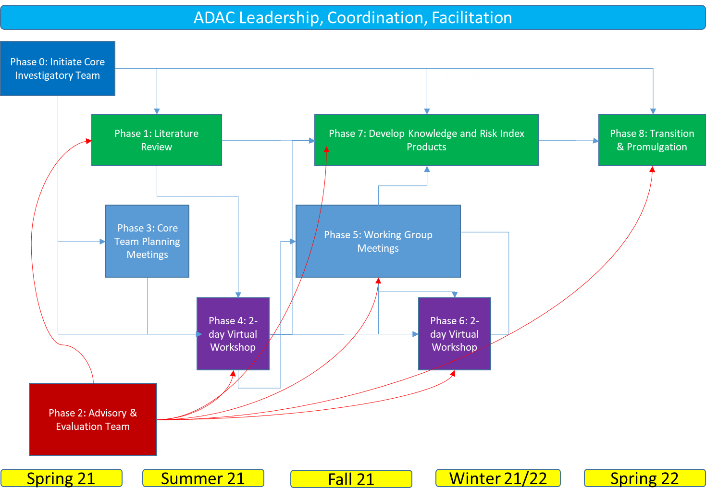
ADAC Program Year 7 Annual Meeting 2-3 June 2021
Environmental Change Risk Index (ERI):
Phased Approach and Milestones
Petty Officer 3rd Class Shawn Keeman (right), an inspector on temporary duty for Coast Guard Sector Anchorage, prepares to inspect a fuel storage facility in Oscarville.

Slide 14
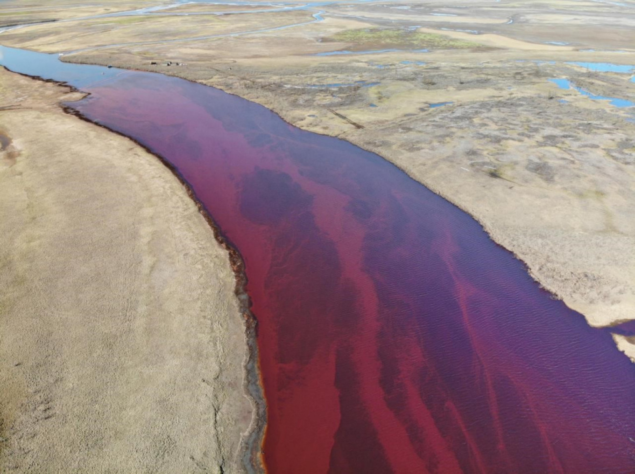
ADAC Program Year 7 Annual Meeting 2-3 June 2021
Environmental Change Risk Index (ERI):
Planned Research Outcomes
The research effort will produce three products:
A comprehensive Arctic facilities and infrastructure environmental change knowledge product,
An operationally relevant Arctic facilities and infrastructure environmental change risk index, and an Arctic inspector, and
Responder structural environmental impacts training guide.
May 2020: Norilsk diesel spill, Russia

Slide 15
ADAC Program Year 7 Annual Meeting 2-3 June 2021
Environmental Change Risk Index (ERI):
Transition Plan
In addition to the three core products, transition includes:
a peer-review journal article will be promulgated across USCG and ADAC networks
knowledge gained from this project will be directly transferable to USCG Facilities Inspections and Maritime Environmental Response, which are to be represented on the Core Team.
knowledge gained and consensus reached will be used to manage facilities inspections schedules, inform inspectors as to the severity of observed environmental changes, and predict expected future condition of USCG supporting infrastructure and Regulated Facilities.
May 2020: Norilsk diesel spill, Russia

Slide 16
ADAC Program Year 7 Annual Meeting 2-3 June 2021
Environmental Change Risk Index (ERI):
Next Steps
UAA IRB review underway
After IRB approval, will await a CAPO determination before project can move forward
Once CAPO approval received, core team can begin to collect information

Slide 17
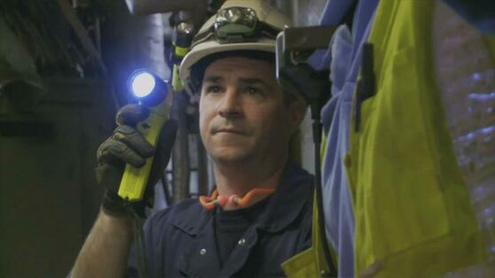
Ready for questions
ADAC Program Year 7 Annual Meeting 2-3 June 2021
Feedback…
What are we missing?
What can we improve?
Who should we connect with to improve odds of research success?
https://www.marinedefenders.org/coast-guard-inspection.html
Notes:
Thank you for the gift of your time and attention.

